Slide 1

Facilitators:
Dr Priyanka Mishra
Dr Lalit Prasad
Welcome!

Slide 2
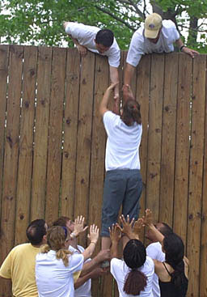
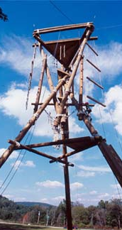
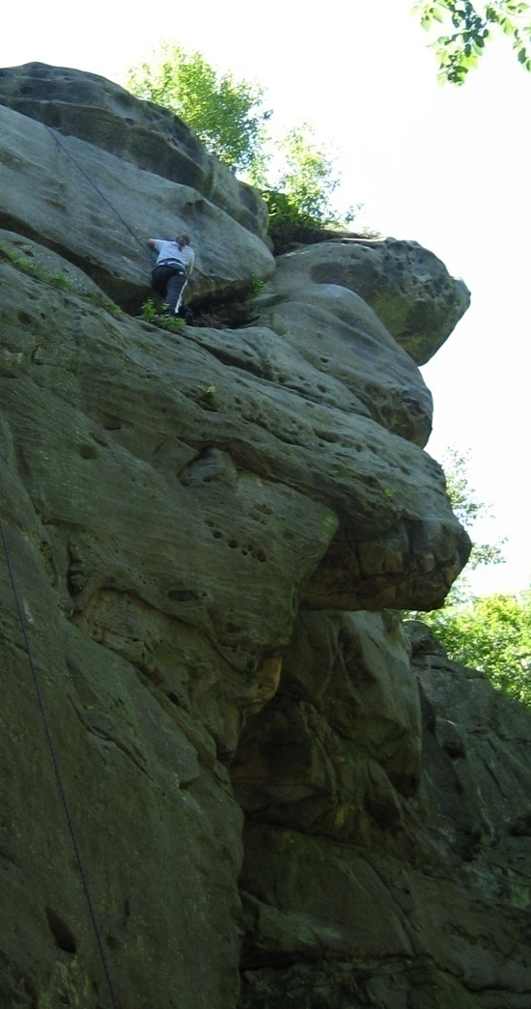
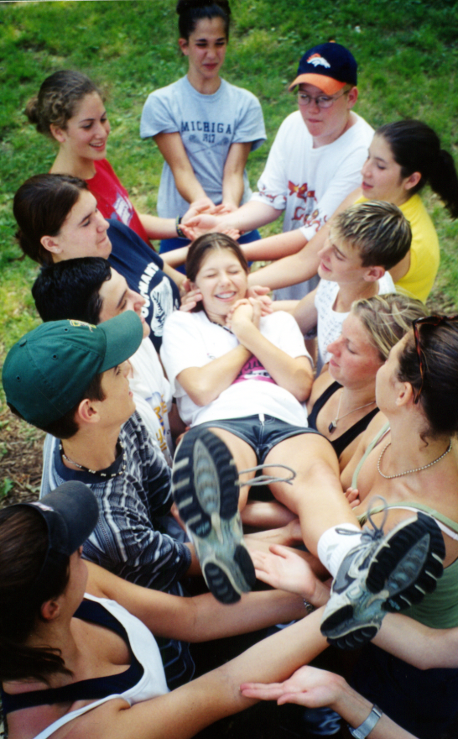
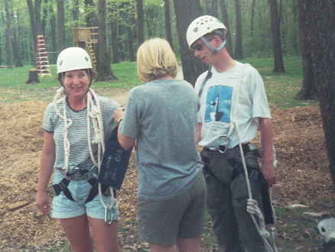

Slide 3
Learning Objectives
To provide a practical overview of team dynamics
To provide multiple exercises to allow for self-discovery and frank conversations
To offer solid tactics for communicating better within the team
To understand what team motivation is and is not, and know how leaders can influence it

Slide 4

Today’s Agenda
It’s going to be a fast-paced and fun-filled day!
Introduction & ice breaking session
Video
Overview of the topic
Activity 1
Stages of Team Building
Activity 2
Role of Leader and Member
Activity 3
Lunch!
Myers-Briggs Type Indicator
Activity 4
Understanding and resolving conflict
Activity 5
Motivational Video

Slide 5
Ice Breaking- Win As Much As You Can

Slide 6
Chak de India.mp4

Slide 7
What is Teamwork & Team Building?
Group and Team: A group is a collection of individuals who coordinate their individual efforts. On the other hand, at team is a group of people who share a common team purpose and a number of challenging goals. Members of the team are mutually committed to the goals and to each other.
Teamwork
Concept of people working together as a team.
Team player
A team player is someone who is able to get along with their
colleagues and work together in a cohesive group.
Team Building
Process of establishing and developing a greater sense of collaboration and trust between members

Slide 8
Developing an Effective Team
Clear sense of purpose
Open, honest communication
Decision by consensus
Creative thinking
Focused on core issues
Set Goals
Define Roles
Positive Deviants Encouraged

Slide 9

Effective Teamwork
Create an agenda & assign duties
Keep notes on meetings
Stay on track
Encourage participation
Build esteem in team members
Check whether the team contract is being upheld

Slide 10
Effective Teamwork
How should you treat others?
The golden rule?
Or the platinum rule?

Slide 11
Golden Rule
"The Ethic of Reciprocity -- often called the Golden Rule in Christianity -- simply states that you are to treat other people as you would wish to be treated yourself." This concept exists throughout hundreds of cultures and therefore intersects with business and workplace behavior.

Slide 12
Platinum Rule
Reverses the Golden Rule and instead asserts that we should treat others how they may wish to be treated. At first glance, this may seem like a rather selfish rendition of the Golden Rule – but it might actually prove more conducive to building and strengthening positive relationships within the workplace.

Slide 13
The Five Finger Rules, general

Slide 14
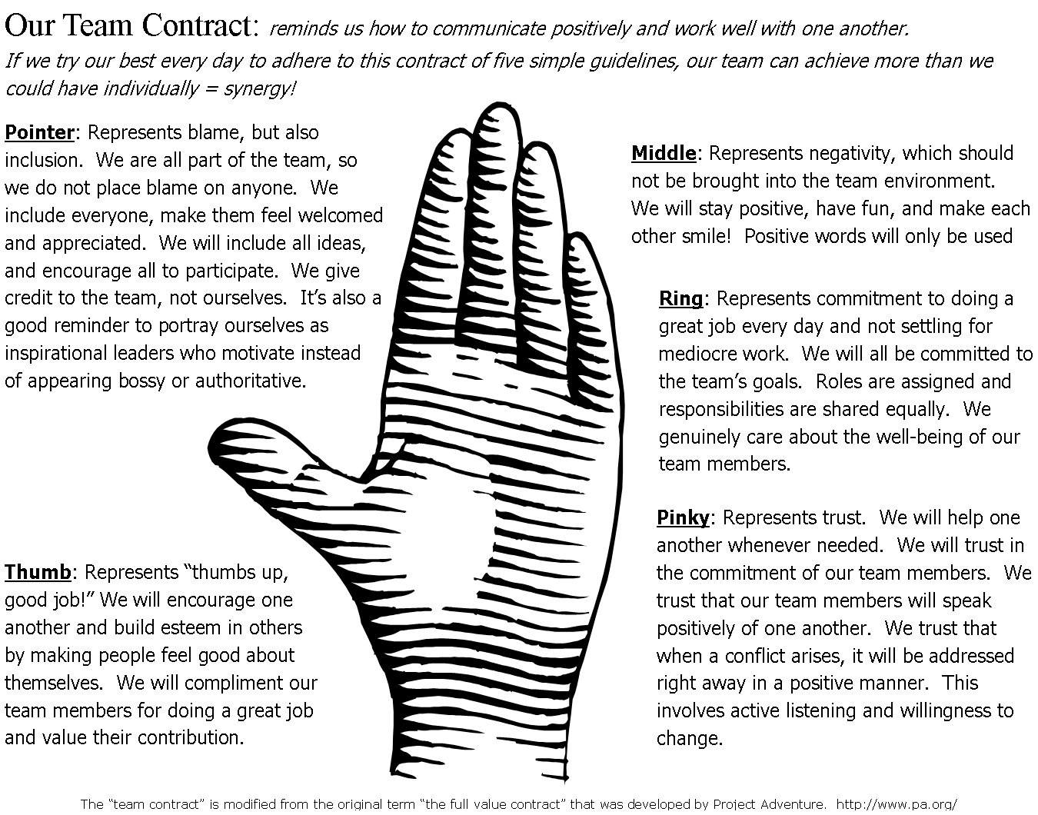

Slide 15

Activity1: Puzzle Game

Slide 16
Stages in Team Building
Forming
Storming
Norming
Performing
Notes:
As the team matures, members gradually learn to cope with each other and the pressures that they face. As a result, the team goes through the fairly predictable stages noted on the slide.

Slide 17

Team Evolution
Orientation
Conflict
Brainstorming
Emergence
Reinforcement
Forming
Storming
Norming
Performing
Adjourning

Slide 18
Stage 1: FORMING
The Team
defines the problem
agrees on goals and formulates strategies for tackling the tasks
determines the challenges and identifies information needed
Individuals take on certain roles
develops trust and communication
Notes:
To help the students adapt to their team, it might be wise to have them to simple activities to build trust and establish communication between the members. However, in the context of the computational science project many of the forming actions are undertaken as the team determines what their project topic will be and narrows the focus to reach their project goal. Teachers can help students as they "form" their teams by making sure that they understand the process they will go through to get their topic.
You may want to include some activities to illustrate trust and/or communication skills in a team.

Slide 19
Stage 2: STORMING
During the Storming stage team members:
  realize that the task is more difficult than they imagined
  have fluctuations in attitude about chances of success
  may be resistant to the task
  have poor collaboration
Notes:
This is probably the most difficult stage for the team. They may be floundering trying to find a project topic that is narrow enough to study or a mentor to help them. They begin to realize that this project is different than other ones that they have done in the past. Teachers can help students through this stage by encouraging members to use their individual skills and assume more responsibilities.
Understanding how personality types interact can ease some of the tensions in the storming stage.

Slide 20
Storming Diagnosis
Do we have common goals and objectives?
Do we agree on roles and responsibilities?
Do our task, communication, and decision systems work?
Do we have adequate interpersonal skills?
Notes:
As a teacher, you can help your students when they are in the “storming” stage, by focusing their attention on the questions above. The students may want to answer the first question both in general terms and more specifically, in conjunction with their project goals.

Slide 21
Stage 3: NORMING
During this stage members accept:
  their team
  team rules and procedures
  their roles in the team
  the individuality of fellow members
Team members realize that they are not going to crash-and-burn and start helping each other.
Notes:
During this stage, team members begin to work out their differences and now have more time and energy to spend on their work. Thus they are able to start making significant progress.
In the context of the computational science project, the students have probably found a mentor who is helping them and have narrowed their project focus.

Slide 22
Stage 4: PERFORMING
Team members have:
  gained insight into personal and team processes
  a better understanding of each other’s strengths and weaknesses
  gained the ability to prevent or work through group conflict and resolve differences
  developed a close attachment to the team
Notes:
During the performing stage, the team is now an effective and cohesive unit. As a team, the emphasize quality work; utilize each member’s talents; meet deadlines; and continue to work on team commitment.
Examples of the results of good team work can be seen on the Video tapes and CDs from the National Expos. The presentation itself is an example of team work.
The duration and intensity of these stages vary from team to team. Sometimes Stage 4 is achieved in a meeting or two; other times it takes months. Understanding the stages of growth will keep you from overreacting to normal problems and setting unrealistic expectations. Don’t panic. With patience and effort the assembly of independent individuals will grow into a team.

Slide 23

Activity 2- Role Storming

Slide 24
Team Roles - Leader
  Encourages and maintains open communication
  Leads by setting a good example
  Motivates and inspires team members
  Helps the team focus on the task
  Facilitates problem solving and collaboration
  Maintains healthy group dynamics
  Encourages creativity and risk-taking
  Recognizes and celebrates team member contributions

Slide 25
Other Team Roles – Members Can Formally or Informally Take on These Roles
  Initiator - Someone who suggests new ideas. One or more people can have this role at a time.
  Recorder - This person records whatever ideas a team member may have. It is important that this person quote a team member accurately and not "edit" or evaluate them.
  Devil's Advocate/Skeptic - This is someone whose responsibility is to look for potential flaws in an idea.
  Optimist - This is someone who tries to maintain a positive frame of mind and facilitates the search for solutions.
  Timekeeper - Someone who tracks time spent on each portion of the meeting.
  Gate Keeper - This person works to ensure that each member gives input on an issue. One strategy to do this is to ask everyone to voice their opinion one at a time. Another is to cast votes.
  Summarizer - Someone who summarizes a list of options.

Slide 26

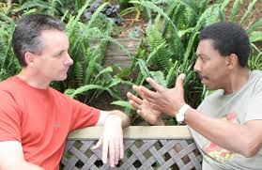
Activity 3 Listen Up

Slide 27
From Individuals A Group Forms
Help members understand each other
  Myers-Briggs Type Indicator (MBTI)
      Extraverts ------------------ Introverts
      Sensors --------------------- INtuitive
      Thinker ---------------------- Feelers
      Judger ----------------------- Perceiver
  By selecting one from each category, we define our personality type, ESTJ, ENTJ…INFP
Notes:
Team members need to understand and appreciate the other individuals or personality types in their group.
History of “type”
In 1921, Carl Jung a psychoanalyst and disciple of Sigmund Freud realized that behavior that seemed unpredictable could be anticipated if one understood the underlying mental functions and attitudes people preferred and published his theory in a book called Psychological Types.
In 1923, Katharine Briggs read Jung’s book, adopted his model and interested her daughter Isabel Briggs Myers in the theory. Myers and Briggs built on Jung’s work, expanded it and gave it a practical application. They determined that there were four personality preference scales and 16 distinct personality types. They developed and began giving their Myer-Briggs Type Indicator (MBTI) test instrument in the 1940s. The four scales are listed on the slide and the definitions of each end of a dimension is:
Extraverts – focus their attention and energy on the world outside of themselves; need to experience the world to understand it.
Introverts – focus their attention and energy on the world inside of themselves; need to understand world before experiencing it.
Sensors – Concentrate on what can be seen, heard, felt, smelled and tasted; focus on what is real and concrete
iNtuitives – interested in meanings, relationships, and possibilities based on facts; focus on implications and inferences
Thinkers – prefer decisions that make sense logically; make decisions by analyzing and weighing the evidence
Feelers – make decisions on how much they care or what they feel is right; view themselves as empathetic and compassionate
Judgers – seek to regulate and control life; like to have issues resolved
Perceivers – seek to understand life rather than controlling it; like to stay open to all kinds of possibilities.

Slide 28
Relevance to Teams (E/I)
Extraverts
  Need to think aloud
  Great explainers
  May overwhelm others
Introverts
  Need time to process
  Great concentration
  May not be heard
Notes:
To be an effective team member:
Extraverts should
Be prepared to stop before you fall into redundancy and overkill
Control your tendency to speak
Make a special effort to listen carefully, avoid interrupting
Stop, Look and Listen
Introverts:
Share more quickly and spontaneously thoughts and ideas
Rule out nothing as being too trivial and meaningless
Don’t hold others to the first words out of their mouths. Push for meaning and clarity

Slide 29
Relevance to Teams (N/S)
iNtuitive
  Great at big picture
  See connections
  May make mistakes in carrying out
  plans
Sensor
  Great executors
  May miss big picture, relative importance
Notes:
To be an effective team member:
iNtuitive’s should:
Use your imagination to show others
Keep as many alternatives on the table as possible
Don’t let facts stifle your creativity
Sensor’s should:
Express the problem in real, tangible and specific terms.
Demand that terms be defined and described accurately and quoted facts are real
Continue to push for common sense

Slide 30

Relevance to Teams (T/F)
Thinker
  Skillful at understanding how anything works
Feeler
  Knows why something matters
Notes:
In order to be an effective team member:
Thinker’s should:
Help others sort out where and when they become too attached to the problem.
Continue to push for precision. Redefine and rephrase the idea
Feeler’s should:
Admit when your personal values are clouding an issue
Make sure everyone gets a chance to speak, is listened to and is affirmed in their ideas, but don’t overemphasize harmony.

Slide 31


Relevance to Teams (J/P)
Judger
  Good at schedules, plans, completion
  Makes decisions easily (quickly)
  May overlook vital issues
Perceiver
  Always curious, wants more knowledge
  May not get around to acting
Notes:
To be an effective team member:
Judger’s should:
Keep the process or task oriented
Help bring definition to the process
Make sure that the goals are turned into action
Perceiver’s should:
Help keep everyone from going with the first solution
Play the devil’s advocate
Don’t keep offering new ideas once the group has defined a solution

Slide 32
What Type are You?
Activity 4 Self-Assessment Test
Jung types http://www.humanmetrics.com/cgi-win/JTypes1.htm
Notes:
There are several online tests that the participants can take to help them identify their personalities. If time permits you may want to pause here and have the participants take one of the tests and discuss the results
Its these personality types that individuals bring to their team during the forming stage. Helping understanding the different types will help the individuals begin to work together.

Slide 33
Understanding Conflict
Is conflict always bad?
  1. No! Conflict brings out new perspectives and can be handled in a positive manner.

Slide 34
Resolving Conflict
Communication
Openness
Research
Flexibility
Fair Play
Alliance

Slide 35
Overcoming Resistance
Express understanding: empathize
Make people aware of their resistance: without blaming, or causing defensiveness
Evaluate others’ objections fairly: talk it out, discover underlying issues
Hold your arguments until the other person is ready: their needs come first, self blame

Slide 36
Recipe for Successful Team
Effective systems and processes
  Clear communication
  Beneficial team behaviors; well-defined decision procedures and ground rules
  Balanced participation
  Awareness of the group process
  Good personal relationships
Notes:
Clear communication: Speak with clarity and be succinct. Listen actively; explore rather than debate each speaker’s ideas. Avoid interrupting.
Beneficial team behaviors: Should encourage all members to use the skills and practices that make discussions and meetings more effective; suggest procedures for meeting goals, clarify or elaborate on ideas; keep the discussion from digressing
Well-defined decision procedures: discuss how decisions will be made; use data as a basis of decisions; explore important issues by polling
Balanced participation: Everyone should participate in discussions and decisions, share commitment to the project’s success and contribute their talents
Established ground rules: Establish ground rules for what will and will not be tolerated in the team
Awareness of group process: Be sensitive to nonverbal communication; be aware of the group process and how the team works together
Use the scientific approach: Of course this is the underlying assumption in a project development, but in team building it helps members avoid team problems and disagreements. Opinions must be supported by data

Slide 37
Recipe for Successful Team
Commitment to shared goals and objectives
Clearly define roles and responsibilities
  Use best skills of each
  Allows each to develop in all areas
Notes:
To summarize, even though these points are addressing teams in the workplace, they are applicable in the classroom setting. They can also form part of the rubric to evaluate the team’s performance.
Clarity in team goals: has a clear vision and can progress steadily toward its goals.
A work plan: helps team determine what advice, assistance, and other resources they need from teachers, mentors or research
Clearly defined role: Uses each member’s talents and involves everyone in team activities so no one feels left out.

Slide 38

Activity 5 Dumb Charades

Slide 39
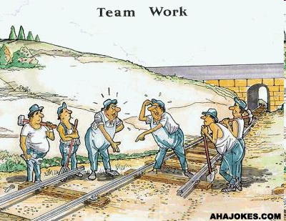
The Results of Team Work

Slide 40
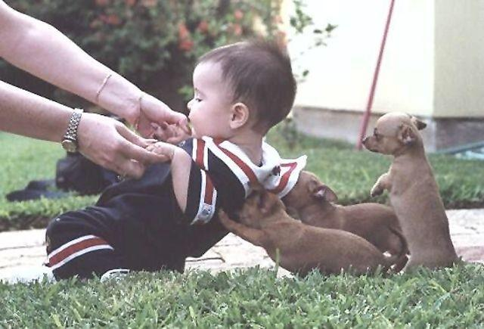
Every Team Member Can Help!

Slide 41
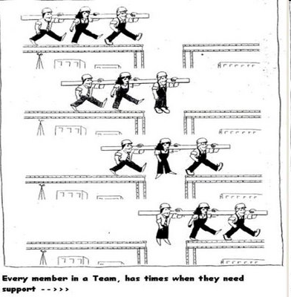

Slide 42
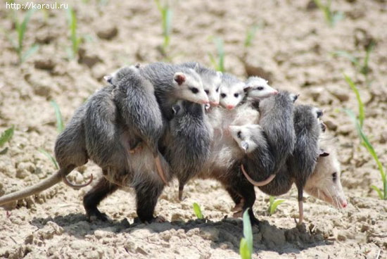
Everyone Has to Hang in There!

Slide 43
https://www.youtube.com/watch?v=O-Hzzg1AtVs

Slide 44
Enjoy your Game!
Every team can be successful!

